Slide 1
26.02.2025
Bachelor‘s Thesis Defence
Leveraging Criticality in Reinforcement Learning for Effective Transfer Learning in Autonomous Driving
Autonomous Vehicle Engineering
Examinee: Daniil Navodey
Examiner: Prof. Dr. Lenz Belzner
Guide: Chidvilas Karpenahalli Ramakrishna

Slide 2
Introduction
Challenge
Reinforcement Learning requires massive data/computing for effective decision-making in complex environments.
Limitation of Traditional Transfer Learning
Random data sampling in Transfer Learning is inefficient. It is more time- and computational power-consuming.
Proposed Solution
Focus the learning process on critical states (safety-critical scenarios) to optimize Transfer Learning.

Slide 3
Related Work
Prioritized Experience Replay (PER):
Gives the higher priority to samples with a higher learning potential based on high Temporal-Difference error. Focuses on error-driven sampling.
Threshold/Peak Variance Methods to Rate Criticality of the State:
Identify critical states via Q-value variance or entropy
Criticality-Based Advice:
Uses critical states to guide exploration.
Literature Gap:
Traditional Transfer Learning uses random data sampling , leading to inefficiency.
Existing criticality research focuses on exploration, not Transfer Learning optimization.
This Work: First to utilise critical states in Transfer Learning Replay Buffer for autonomous driving environment.
Can critical states replace random data in Transfer Learning?
Does this approach reduce training time?
Does this approach maintain safety and efficiency?

Slide 4


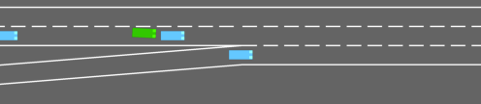
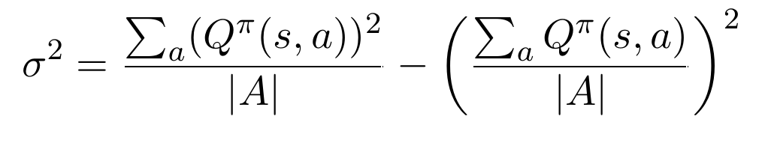
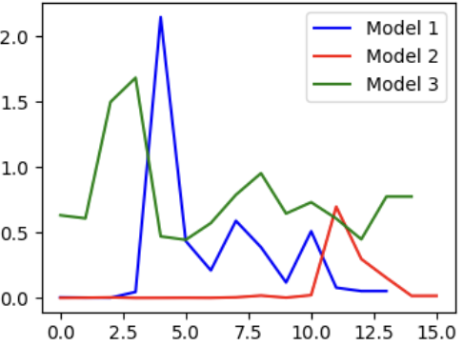
Methodology
Environments: Highway-Env → Merge-Env
Reinforcement Learning Algorithm: Deep Q-Network(DQN) with Stable-Baselines3.
Criticality Definition: States where local peaks of variance of actions Q-values is observed.
Replay Buffer: Pre-filled with critical states for Transfer Learning.

Slide 5
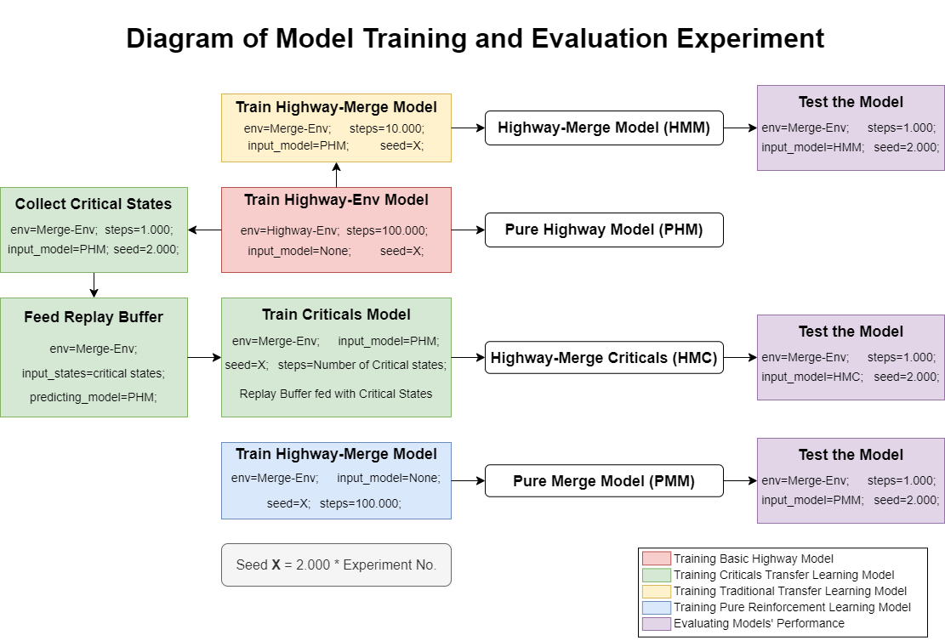

Slide 6
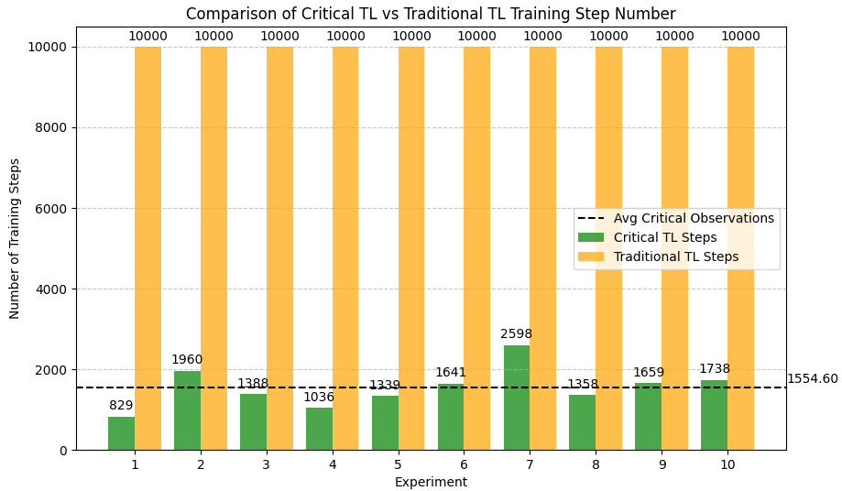
Training Steps Reduction
Performance Results
Traditional Transfer Learning
Number of training steps = 10.000
Empty Replay Buffer -> filling with random samples
Criticality approach in Transfer Learning
Number of training steps = 829-2598 (avg. 1155)
Pre-filled Replay Buffer with critical states
Average training step number reduction: 6.4 times

Slide 7
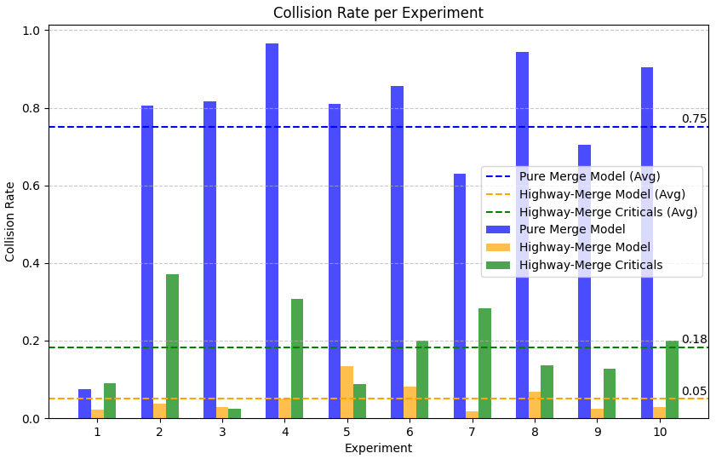
Collision Rate
Performance Results
General tendency: in average, collision rate is higher than in traditional Transfer Learning
Outperforming in Experiments 3 and 5
Higher range of values – lower stability

Slide 8
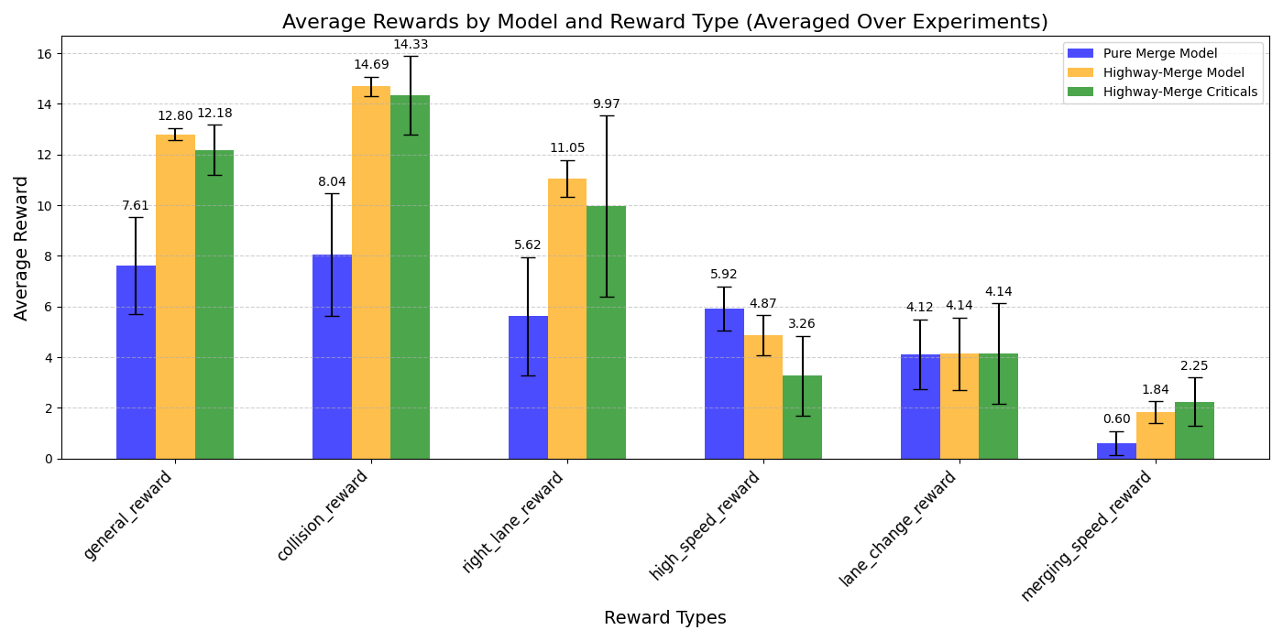
Rewards
Performance Results
Comparable reward values
Higher range of values – lower stability
Prioritisation of safety-related rewards over high-speed reward

Slide 9
Future Work
Optimise the Replay Buffer sampling
Explore dynamic criticality sampling.
Test in more complex environments.
Combine with other Reinforcement Learning algorithms (SAC, PPO).

Slide 10
Conclusion
Strengths :
Reduces computational costs.
Maintains safety and performance.
Prospective improvements :
Stability issues in some experiments.
Ensuring the use of all critical states from in Replay Buffer.
Result:
Criticality-based Transfer Learning is applicable in autonomous driving.
Balances efficiency and safety.
Opens doors for optimized real-world RL applications.

Slide 11
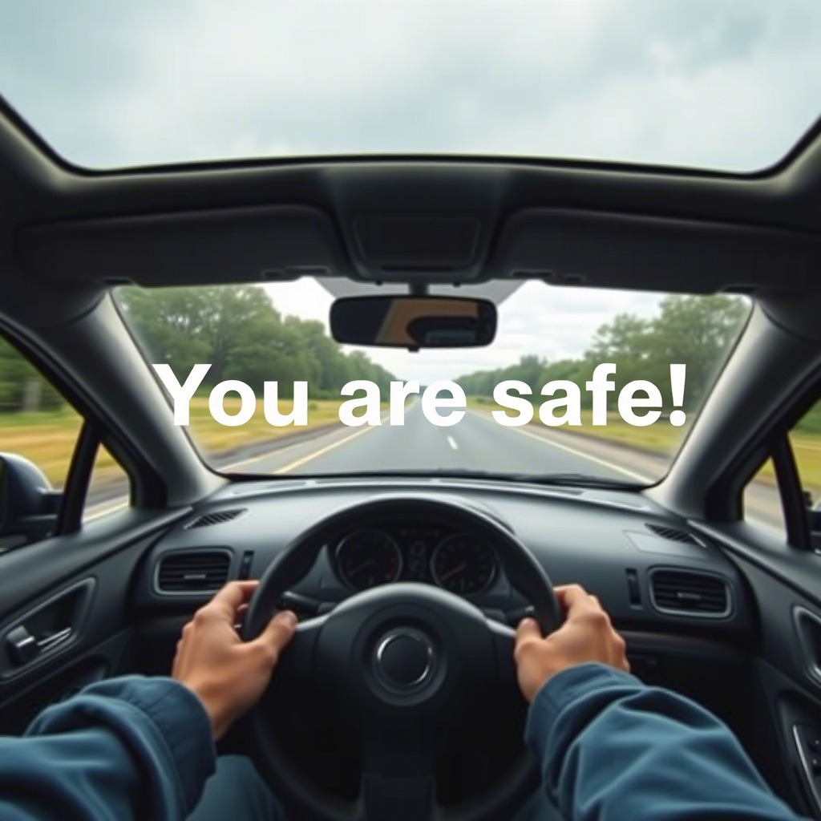
Thank You!
Q&A

